Slide 1
CyberSentinel
Sprint 1 By Team Tech Titans

Slide 2
Agenda
01
02
03
Team & Planning
User & Product Definition
Technology & Implementation
04
05
06
Tracking & Evaluation
Demonstrations & Resources
Project Documentation & Management
Team Roles & Responsibilities
Improvements Based on Professor Feedback
Project Description
Team Working Agreement
Personas
Minimum Viable Product (MVP)
Technologies
Algorithms
Metrics & Progress Tracking
Sprint 1 Retrospective
Sprint 2 Planning
Project Demo - Sprint 1
GitHub Repository Link
Live Application Demo
Diagrams
Product Backlog
Sprint 1 Backlog

Slide 3
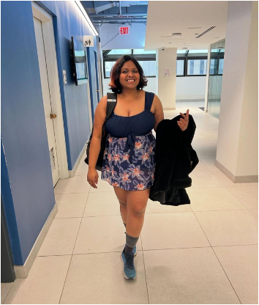


Team Members
Vaishnavi Dasari
Snehitha Bodiga
Aasritha Bhimisetty
Machine learning Engineer
Full Stack Developer
Frontend Developer

Slide 4
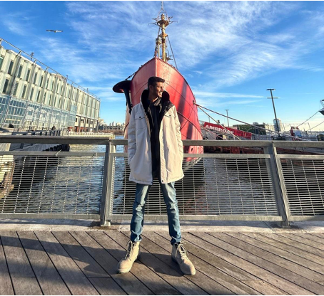


Team Members
Abisainath
Shoib Khan Patan
Dhanush Kolapalli
Backend Developer
Backend Developer
Machine Learning Engineer

Slide 5

Team Members
Neelkamal Rana
Full Stack Developer

Slide 6
Improvements
Addition of Team page
Fixing the wikipage.
Fixing up the team agreement.

Slide 7
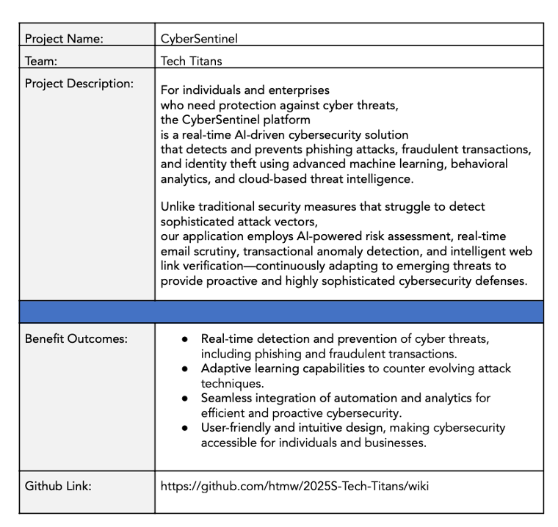


Project Description

Slide 8
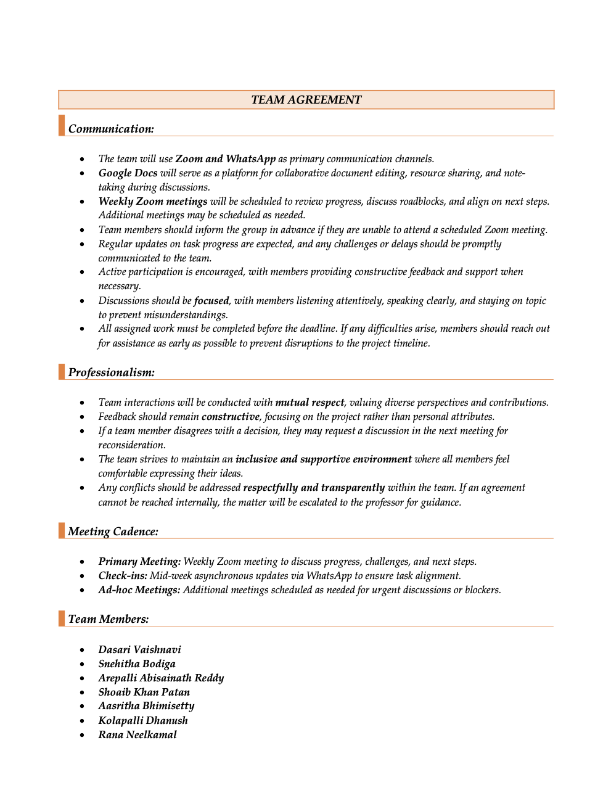
Team Agreement

Slide 9
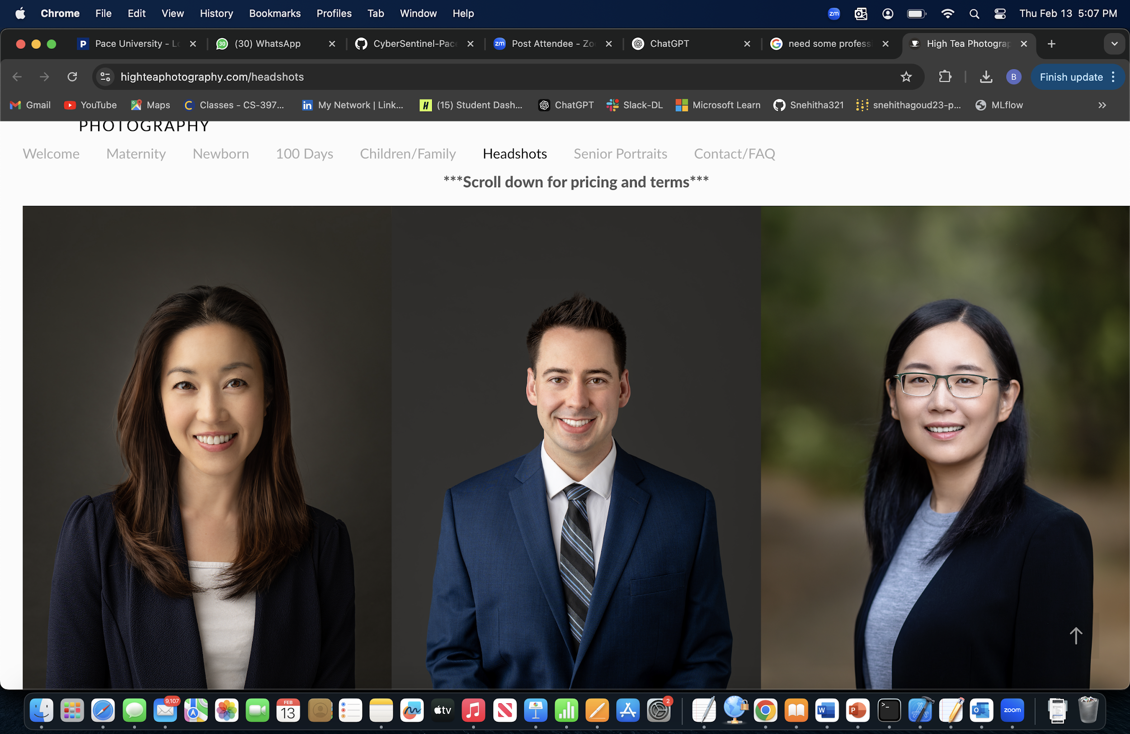
Persona
Alex works at a mid-sized tech company and is well-versed in various technologies. Spends considerable time online, both professionally and personally. Aware of cybersecurity threats but seeks advanced tools to enhance personal security.
Goals:
Protect personal and professional data from phishing and other cyber threats.
Stay informed about the latest cybersecurity practices.
Utilize AI-driven solutions for proactive threat detection.
Challenges:
Balancing convenience with robust security measures.
Identifying trustworthy cybersecurity tools amidst numerous options.
Name: Alex Johnson
Age: 32
Occupation: Software Developer

Slide 10
Persona
Manages a team remotely for a marketing firm. Juggles professional responsibilities with parenting two teenagers. Uses multiple devices for work and personal tasks.
Goals:
- Ensure the security of sensitive work-related information.
- Protect family members, especially children, from online threats.
- Maintain a secure digital environment across all devices.
Challenges:
- Limited time to manage and monitor cybersecurity measures.
- Keeping up with evolving cyber threats and ensuring family compliance with best practices.
Name: Maria Thompson
Age: 40
Occupation: Project Manager

Slide 11
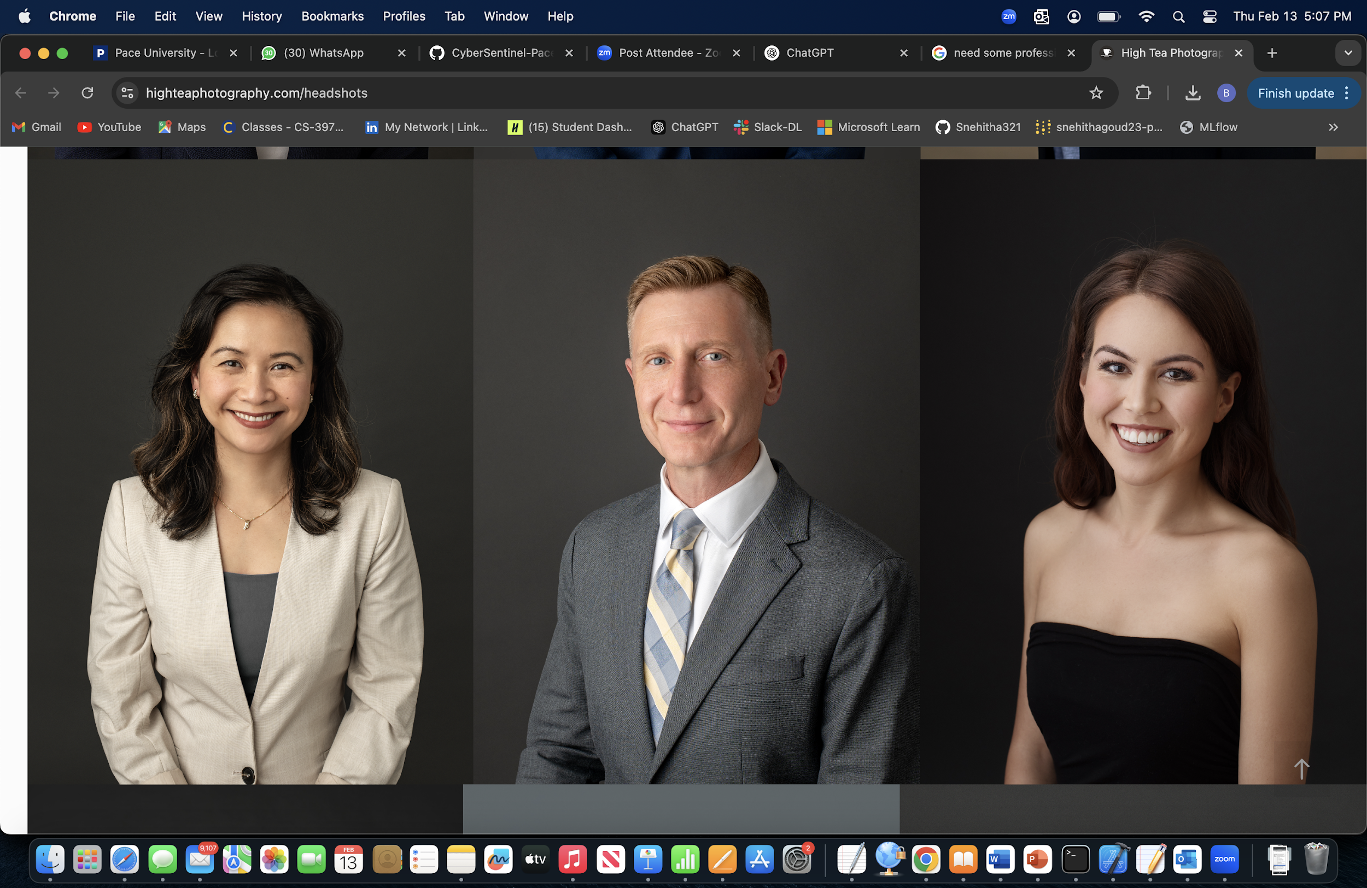
Persona
Runs an online storefront in addition to the physical store. Handles customer data, including payment information. Has basic knowledge of cybersecurity but lacks specialized expertise.
Goals:
- Protect customer data to maintain trust and comply with regulations.
- Prevent financial losses due to cyber attacks.
- Implement cost-effective security solutions without extensive technical knowledge.
Challenges:
- Limited budget for cybersecurity investments.
- Difficulty in assessing which security measures are necessary and effective.
Name: David Kim
Age: 45
Occupation: Owner of a local retail store

Slide 12
Minimum Viable Product (MVP)
Phishing Email Detection – Classifies emails as safe or phishing using NLP models trained on datasets.
Fraudulent Transaction Detection – Identifies suspicious transactions using anomaly detection techniques.
URL Classification – Determines if a website link is malicious or safe based on its lexical features.
User Dashboard – Displays alerts and risk analysis based on detected threats.

Slide 13




Technologies – Development Stack
Frontend: React.js (for simple and interactive UI)
Backend: Flask (lightweight Python-based API)
Database: PostgreSQL (to store detected threat data)
Hosting: AWS (for cloud deployment and scalability)

Slide 14



Technologies - AI & Cybersecurity Tools
Machine Learning: Scikit-learn, PyTorch (for phishing and fraud detection)
Security: OAuth 2.0 (for authentication), OpenCV (for URL analysis)
Threat Detection Models: NLP-based phishing email classification, anomaly detection for fraudulent transactions, and URL classification algorithms

Slide 15
Algorithms
Phishing Email Detection:
Algorithm: BERT (Bidirectional Encoder Representations from Transformers)
Utilizes a pre-trained deep learning model for text classification.
Captures contextual meaning of words, improving phishing email detection.
Fine-tuned on phishing email datasets for high accuracy.
Fraudulent Transaction Detection:
Algorithm: Autoencoder with Isolation Forest
Autoencoder reduces dimensionality and extracts essential transaction features.
Isolation Forest detects anomalies based on learned representations.
Efficient for unsupervised learning, detecting fraud without requiring labeled data.
URL Classification:
Algorithm: CNN + LSTM (Convolutional Neural Network + Long Short-Term Memory)
CNN extracts spatial features from URL structure.
LSTM captures sequential patterns, improving detection of phishing URLs.
Hybrid deep learning model for better performance over traditional classifiers.

Slide 16
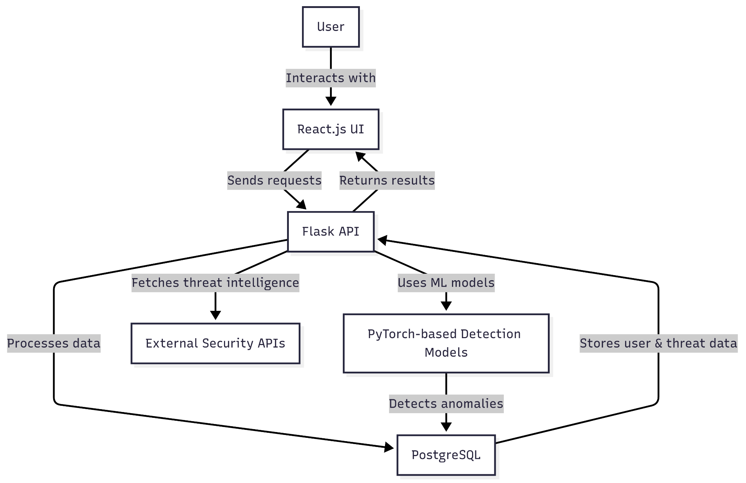
Architecture Diagram

Slide 17
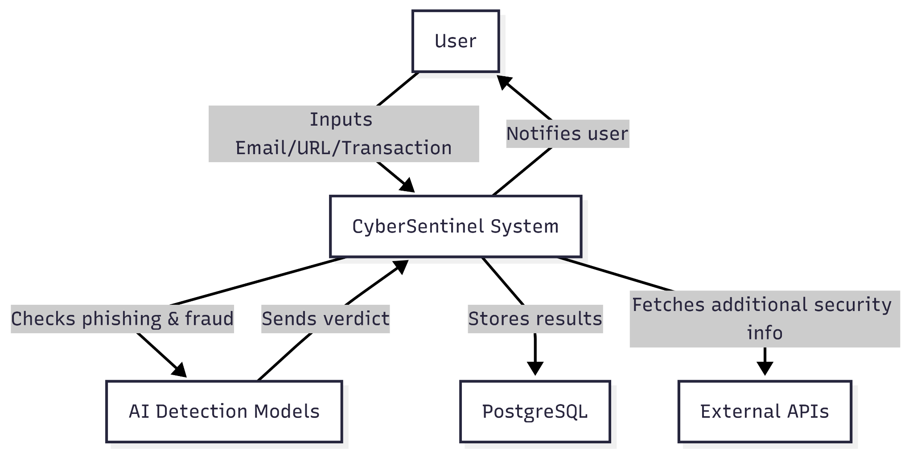
Context Diagram

Slide 18
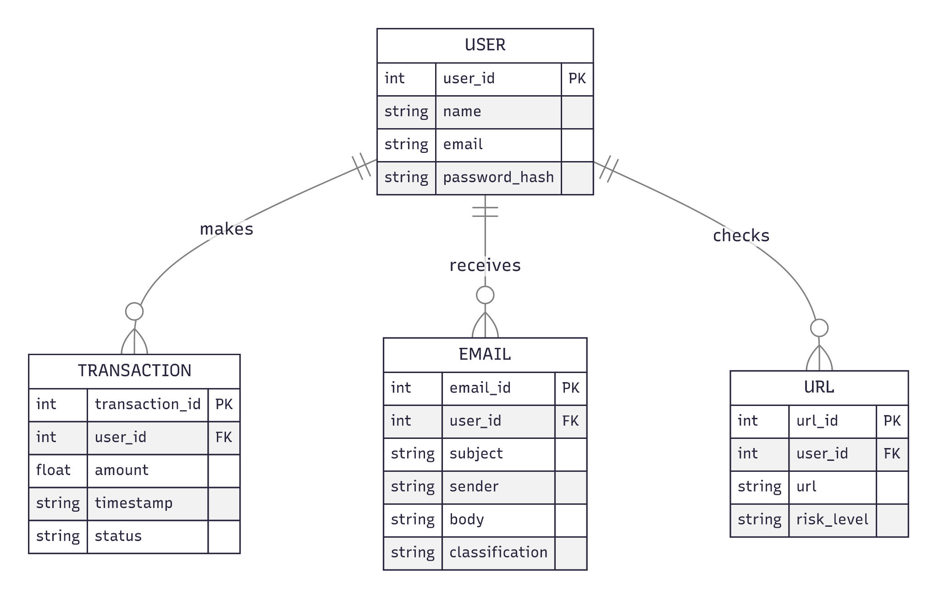
ER Diagram

Slide 19
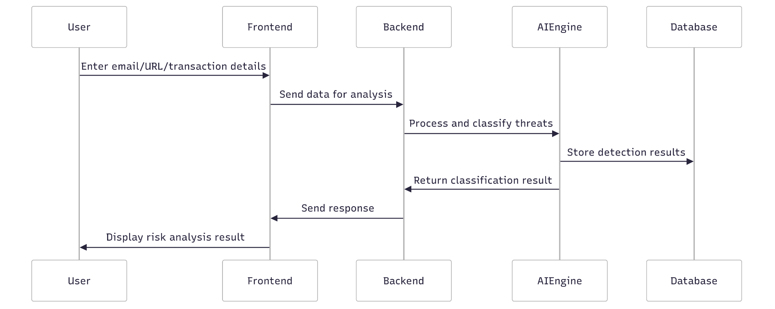
Sequence Diagram

Slide 20
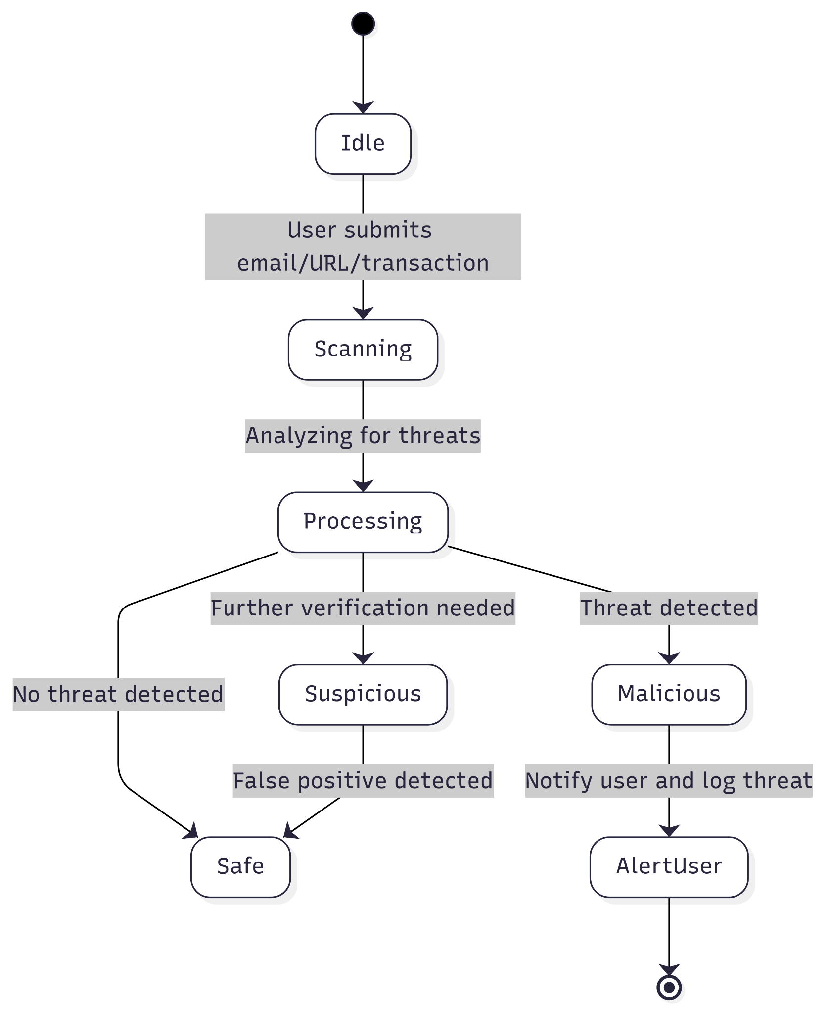
State Diagram

Slide 21
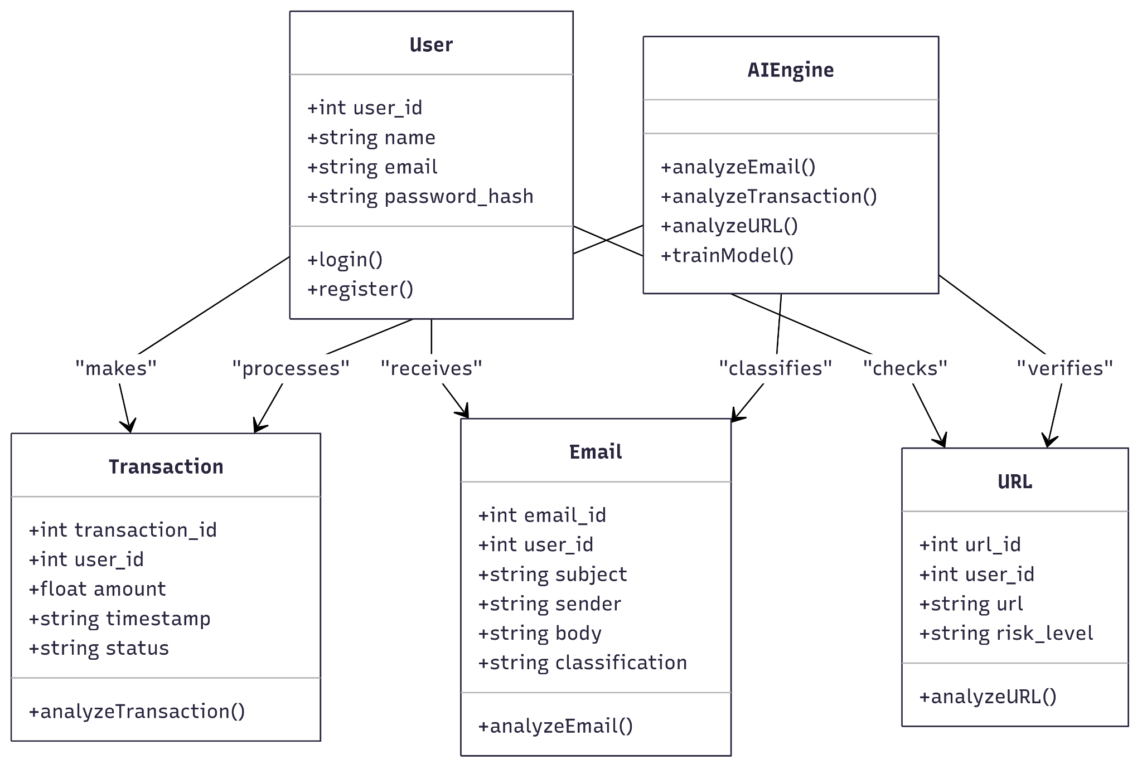
Class Diagram

Slide 22
Product Backlog - User Stories
ID | User Story | Acceptance Criteria | Feature | Sprint | Story Points
US_01 | As a user, I want a dashboard to view phishing email history so that I can track past threats. | Dashboard displays list of phishing emails with filtering options. | Dashboard & Reporting | Sprint 1 | 5
US_02 | As a user, I want to filter emails based on risk level so that I can quickly identify dangerous emails. | System allows filtering by safe, suspicious, and phishing categories. | Phishing Email Filtering | Sprint 1 | 3
US_03 | As an admin, I want to view statistics on detected threats so that I can analyze system performance. | Dashboard provides statistics on phishing, fraud, and malicious URLs. | Threat Statistics | Sprint 1 | 8
US_04 | As an admin, I want to manage user roles and permissions so that I can control access levels. | System supports different access levels for users and admins. | User Management | Sprint 1 | 8
US_05 | As a user, I want to upload an email for phishing detection so that I can know if it's safe. | System classifies email as safe, suspicious, or phishing with an alert. | Phishing Email Detection | Sprint 2 | 8

Slide 23
Product Backlog - User Stories
ID | User Story | Acceptance Criteria | Feature | Sprint | Story Points
US_06 | As a user, I want to upload transaction data so that I can detect fraudulent activities. | System flags transaction as normal or suspicious with a confidence score. | Fraudulent Transaction Detection | Sprint 2 | 13
US_07 | As a user, I want to check if a URL is malicious so that I can avoid phishing sites. | System checks URL structure and domain reputation, classifying it as safe, suspicious, or malicious. | URL Classification | Sprint 2 | 5
US_08 | As a user, I want to verify if a sender email is trustworthy so that I can decide whether to engage with the sender. | System checks sender reputation and displays a trust score. | Sender Reputation Check | Sprint 2 | 8
US_09 | As a user, I want to receive real-time alerts for detected threats so that I can take immediate action. | User receives notifications via email or app for detected threats. | Real-time Alerts | Sprint 3 | 8
US_10 | As a user, I want an option to report a false positive classification so that I can help improve detection accuracy. | Users can flag an incorrect detection for review. | User Feedback System | Sprint 3 | 3

Slide 24
Product Backlog - Technical Stories
ID | Technical Story | Acceptance Criteria | Feature | Sprint | Story Points
TS_01 | Create a dashboard for threat statistics so that admins can monitor system performance. | Dashboard displays data on detected threats. | Threat Statistics | Sprint 1 | 8
TS_02 | Design a user role management system so that access levels can be controlled efficiently. | Admins can assign permissions to different user roles. | User Management | Sprint 1 | 8
TS_03 | Implement OAuth authentication for secure user access so that users can log in securely. | User authentication is secure, and access tokens work correctly. | Security & Authentication | Sprint 1 | 5
TS_04 | Set up AWS for cloud deployment so that the system can be scalable and accessible. | Backend deployed and accessible via API. | Cloud Deployment | Sprint 1 | 5
TS_05 | Integrate BERT model for phishing email detection so that emails can be classified accurately. | Model achieves at least 90% accuracy on test data. | AI Model Training | Sprint 2 | 8

Slide 25
Product Backlog - Technical Stories
ID | Technical Story | Acceptance Criteria | Feature | Sprint | Story Points
TS_06 | Implement Autoencoder + Isolation Forest for fraud detection so that anomalies in transactions can be detected. | Model correctly classifies anomalies in dataset. | AI Model Training | Sprint 2 | 13
TS_07 | Deploy CNN + LSTM model for URL detection so that phishing websites can be identified. | Model classifies URLs with at least 85% accuracy. | AI Model Training | Sprint 2 | 8
TS_08 | Implement email sender verification model so that sender reputation can be assessed. | System provides a sender trust score based on reputation. | Sender Reputation Check | Sprint 2 | 5
TS_09 | Develop a notification system for real-time alerts so that users are informed of potential threats. | Users receive accurate notifications for detected threats. | Notification System | Sprint 3 | 8
TS_10 | Develop a feedback mechanism for false positive reports so that the system can improve over time. | Users can flag and submit incorrect classifications for review. | User Feedback System | Sprint 3 | 3

Slide 26
Sprint 1 Backlog
ID | User Story | Acceptance Criteria | Feature | Story Points
US_01 | As a user, I want a dashboard to view phishing email history so that I can track past threats. | Dashboard displays list of phishing emails with filtering options. | Dashboard & Reporting | 5
US_02 | As a user, I want to filter emails based on risk level so that I can quickly identify dangerous emails. | System allows filtering by safe, suspicious, and phishing categories. | Phishing Email Filtering | 3
US_03 | As an admin, I want to view statistics on detected threats so that I can analyze system performance. | Dashboard provides statistics on phishing, fraud, and malicious URLs. | Threat Statistics | 8
US_04 | As an admin, I want to manage user roles and permissions so that I can control access levels. | System supports different access levels for users and admins. | User Management | 8
TS_01 | Create a dashboard for threat statistics so that admins can monitor system performance. | Dashboard displays data on detected threats. | Threat Statistics | 8

Slide 27
Sprint 1 Backlog
ID | User Story | Acceptance Criteria | Feature | Story Points
TS_02 | Design a user role management system so that access levels can be controlled efficiently. | Admins can assign permissions to different user roles. | User Management | 8
TS_03 | Implement OAuth authentication for secure user access so that users can log in securely. | User authentication is secure, and access tokens work correctly. | Security & Authentication | 5
TS_04 | Set up AWS for cloud deployment so that the system can be scalable and accessible. | Backend deployed and accessible via API. | Cloud Deployment | 5

Slide 28
Test Cases Sprint 1
Story ID | Test Case | Expected Outcome | Actual Outcome | Pass/Fail
US_01 | Verify that the dashboard displays a list of phishing emails. | Emails are displayed with filtering options. | Emails displayed, filtering working correctly. | Pass
US_02 | Test email filtering by risk level (safe, suspicious, phishing). | Emails are categorized correctly based on risk. | Emails categorized correctly. | Pass
US_03 | Verify that statistics on phishing, fraud, and malicious URLs are displayed correctly. | Statistics are accurate and match the database records. | Statistics displayed correctly. | Pass
US_04 | Test user role management to ensure different permissions apply correctly. | Users with different roles have the correct access. | Role-based access not working as expected. | Fail

Slide 29
Test Cases Sprint 1
Story ID | Test Case | Expected Outcome | Actual Outcome | Pass/Fail
TS_01 | Validate that the dashboard correctly retrieves and displays threat statistics. | Data loads correctly without errors. | Dashboard loads data correctly. | Pass
TS_02 | Verify that admins can create, modify, and delete user roles. | Role-based access control works as expected. | Role modifications failing due to permission errors. | Pass
TS_03 | Test OAuth login to confirm secure authentication and token generation. | Users can log in securely and receive valid tokens. | Authentication failing, token issue detected. | Fail
TS_04 | Verify AWS deployment accessibility. | The system is deployed and can be accessed via API. | Deployment unsuccessful, API inaccessible. | Pass

Slide 30
Sprint 1 Stories Completed
ID | User Story / Task | Story Points
US_01 | As a user, I want a dashboard to view phishing email history so that I can track past threats. | 5
US_02 | As a user, I want to filter emails based on risk level so that I can quickly identify dangerous emails. | 3
US_03 | As an admin, I want to view statistics on detected threats so that I can analyze system performance. | 8
TS_01 | Create a dashboard for threat statistics so that admins can monitor system performance. | 8
TS_02 | Design a user role management system so that access levels can be controlled efficiently. | 8
TS_04 | Set up AWS for cloud deployment so that the system can be scalable and accessible. | 5
Total Completed Story Points: 37

Slide 31
Sprint 1 Stories Not Completed
ID | User Story / Task | Story Points
US_04 | As an admin, I want to manage user roles and permissions so that I can control access levels. | 8
TS_03 | Implement OAuth authentication for secure user access so that users can log in securely. | 5
Total Not Completed Story Points: 13

Slide 32
Team Velocity
Total Story Points Completed: 37

Slide 33
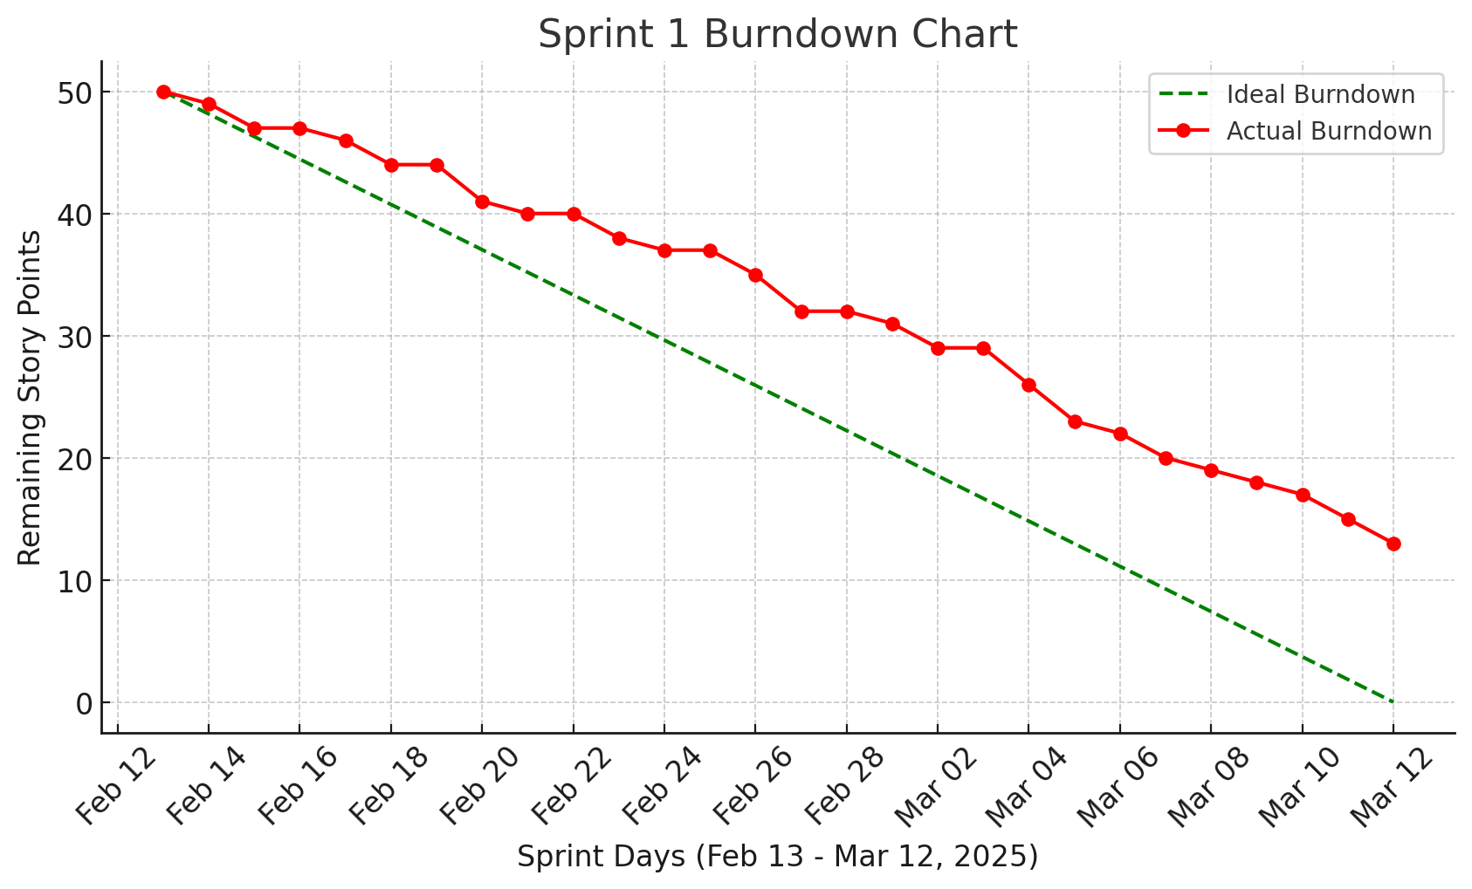
Burn Down Chart

Slide 34
Completed/Committed Ratio
50
37
74%
Completed Story Points
Completed/Committed Ratio
Committed Story Points

Slide 35
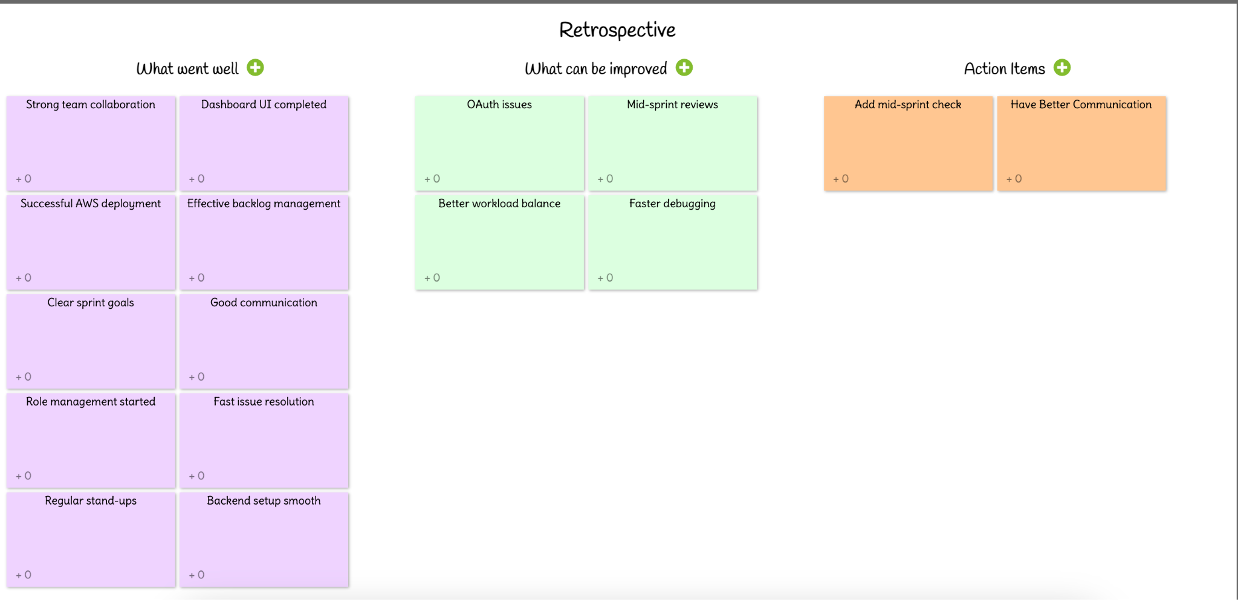
Retrospective

Slide 36
Sprint 2 Planning
ID | User Story / Task | Acceptance Criteria | Feature | Story Points
US_04 | As an admin, I want to manage user roles and permissions so that I can control access levels. | System supports different access levels for users and admins. | User Management | 8
TS_03 | Implement OAuth authentication for secure user access so that users can log in securely. | User authentication is secure, and access tokens work correctly. | Security & Authentication | 5
US_05 | As a user, I want to upload an email for phishing detection so that I can know if it's safe. | System classifies email as safe, suspicious, or phishing with an alert. | Phishing Email Detection | 8
US_06 | As a user, I want to upload transaction data so that I can detect fraudulent activities. | System flags transaction as normal or suspicious with a confidence score. | Fraudulent Transaction Detection | 13
US_07 | As a user, I want to check if a URL is malicious so that I can avoid phishing sites. | System checks URL structure and domain reputation, classifying it as safe, suspicious, or malicious. | URL Classification | 5

Slide 37
Sprint 2 Planning
ID | User Story / Task | Acceptance Criteria | Feature | Story Points
US_08 | As a user, I want to verify if a sender email is trustworthy so that I can decide whether to engage with the sender. | System checks sender reputation and displays a trust score. | Sender Reputation Check | 8
TS_05 | Integrate BERT model for phishing email detection so that emails can be classified accurately. | Model achieves at least 90% accuracy on test data. | AI Model Training | 8
TS_06 | Implement Autoencoder + Isolation Forest for fraud detection so that anomalies in transactions can be detected. | Model correctly classifies anomalies in dataset. | AI Model Training | 13
TS_07 | Deploy CNN + LSTM model for URL detection so that phishing websites can be identified. | Model classifies URLs with at least 85% accuracy. | AI Model Training | 8

Slide 38
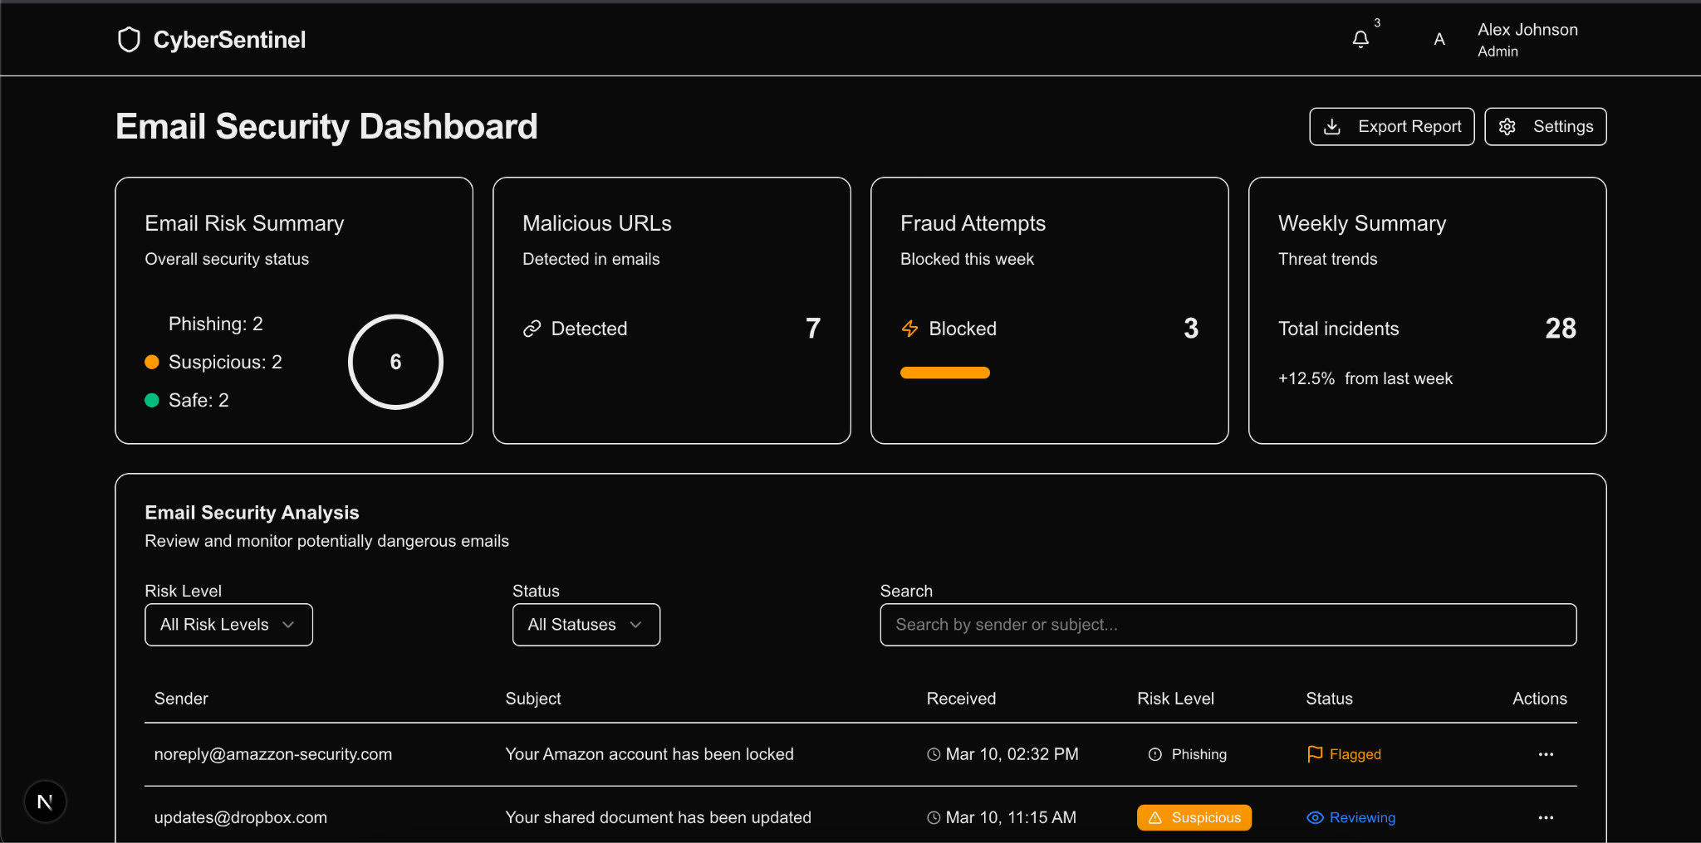
Application Screenshots

Slide 39
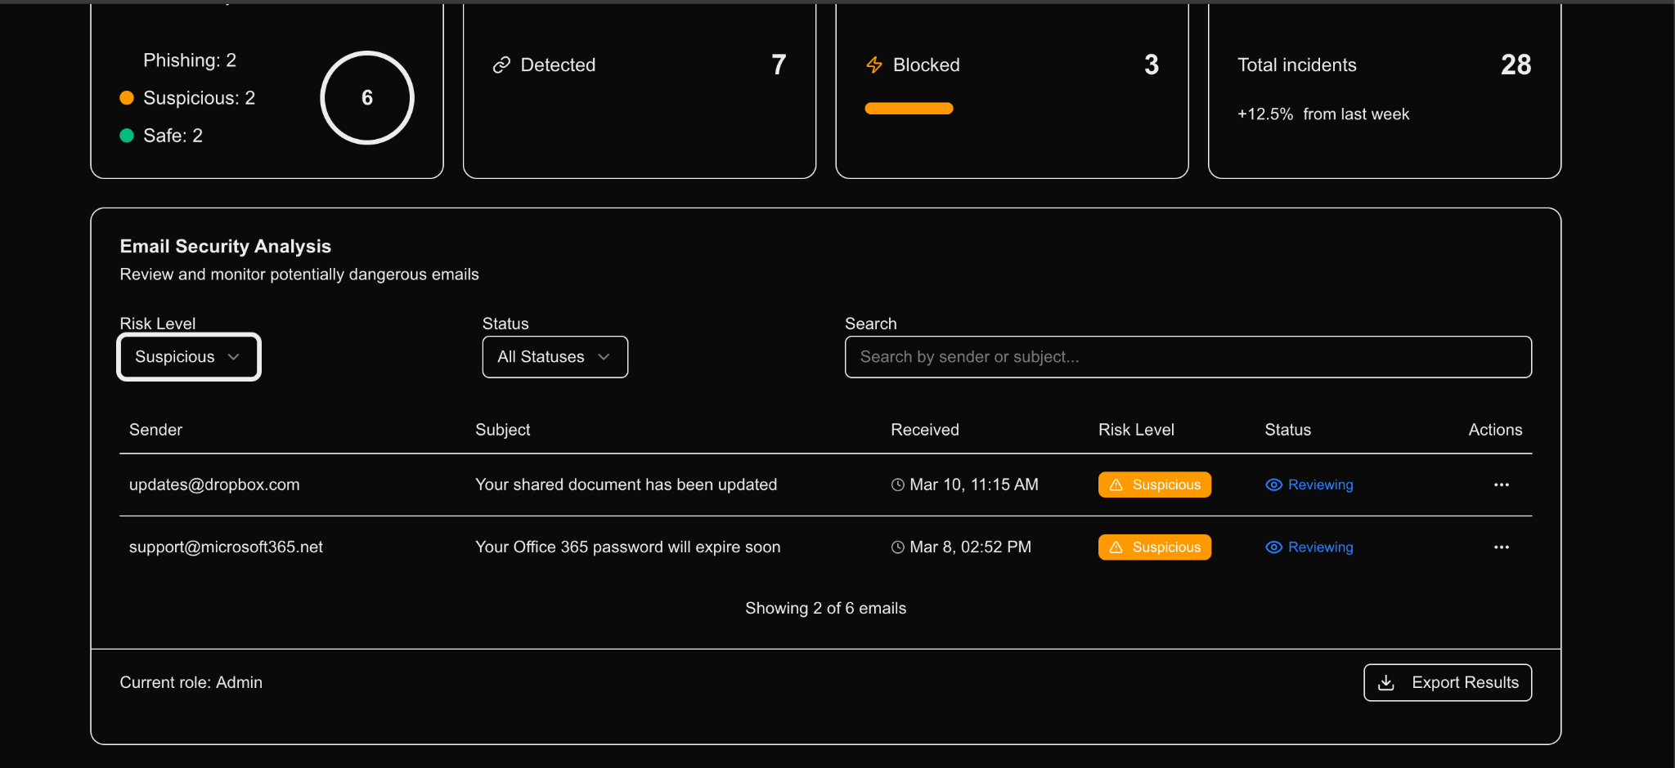
Application Screenshots

Slide 40
Github Wikipage Link
https://github.com/htmw/2025S-Tech-Titans/wiki

Slide 41
Application Demo

Slide 42


